Slide 1
SMART PERSONAL FINANCE AUTOMATOR
CSE7101- Capstone Project
Review-2
Batch Number:CSE_79
Roll Number | Student Name
20221CSE0493 20221CSE0334 20221CSE0492 | Arunachalam T Rakshitha DS Vaishnavi Sastry S
Under the Supervision of,
Ms.Sreelatha PK
Assistant Professor
School of Computer Science and Engineering
Presidency University
Name of the Program: B.Tech CSE
Name of the HoD: Dr. Asif Mohammed
Name of the Program Project Coordinator: Dr. Jayavadivel Ravi
Name of the School Project Coordinators: Dr. Sampath A K , Dr. Geetha A

Slide 2
Problem Statement Number:
Organization : Smart Automation
Category (Hardware / Software / Both) : Software
Problem Description : The "Smart Personal Finance Automator" is a web-based application designed to address the challenges of manual expense management. The system will automatically ingest and parse financial transaction data from bank SMS and email alerts. Using Natural Language Processing (NLP), it will intelligently extract key details like transaction amount, vendor, and date. This structured data is then used to auto-categorize expenses and generate interactive visual reports. The platform aims to provide users with a seamless and insightful overview of their spending patterns and offer personalized recommendations to improve their budgeting and saving habits, ultimately fostering better financial health.

Slide 3
Content
Abstract
Literature Survey
Objectives
Existing methods and drawbacks
Proposed method and Feasibility study
Architecture Diagram
Modules
Hardware and Software Details
Timeline(Gantt Chart)
References

Slide 4
Literature Survey
The development of intelligent personal finance systems draws upon advancements in
natural language processing (NLP), visualization frameworks, machine learning,
and financial technology innovations. Several studies and tools have shaped this field,
providing insights that directly inform the design of the Smart Personal Finance
Automator.
A. Natural Language Processing Foundations
Bird, Klein, and Loper [1] provided one of the earliest and most comprehensive resources
for applying NLP in real-world tasks through their work Natural Language Processing
with Python. Their book laid the groundwork for tokenization, parsing, and entity
recognition, which remain essential for analyzing unstructured financial text. Building on
this foundation, spaCy [3] has emerged as a modern NLP library offering high-
performance entity extraction and classification capabilities. Its industrial-strength
pipeline makes it particularly useful for tasks like identifying transaction amounts,
merchants, and dates in SMS and email messages.

Slide 5
Literature Survey
B. Visualization and User Interaction
The role of visualization in decision-making has been well-documented. Chen, Chiang, and Storey [7] highlighted how business intelligence and analytics transform large volumes of raw data into meaningful insights that support strategic choices. Tools like Plotly’s Dash [2] extend this idea by offering interactive, web-based dashboards suitable for personal use. These dashboards allow users to track expenses visually, spot trends, and make informed financial decisions in real time.
C. Machine Learning and Deep Learning Applications
Abadi et al. [4] introduced TensorFlow, a scalable machine learning framework that enables the training and deployment of large models across diverse domains. While primarily used for enterprise-level AI applications, TensorFlow provides the backbone for experiments in financial text classification and predictive analytics. LeCun, Bengio, and Hinton [8] further advanced the field with deep learning, showing its potential for complex tasks such as fraud detection, anomaly detection, and financial forecasting. Syntetos and Boylan [9] demonstrated how machine learning can be applied specifically for financial decision-making by forecasting expenses and budgeting needs. Together, these contributions show how AI techniques can improve financial planning and enhance user trust through accurate predictions.

Slide 6
Literature Survey
D. FinTech and Personal Finance Systems
The shift towards digitalization in financial services has been widely studied. Agarwal and Dhar [5] reviewed the role of digital technologies in promoting financial inclusion, especially in developing economies. Their findings stress the importance of user-friendly, accessible platforms that adapt to local contexts. Jain, Kumar, and Singh [6] specifically focused on AI-driven personal finance management systems, showing that categorization and recommendation features can enhance budgeting practices. Similarly, Singh and Malhotra [10] analyzed the disruptive role of FinTech in reshaping financial services, noting opportunities in personalized finance and consumer-oriented applications.
E. Research Gap
While existing literature demonstrates the strengths of NLP, machine learning, visualization, and FinTech in isolation, their integration into a single system tailored for individuals remains underexplored. Most prior systems either focused on structured data inputs, enterprise applications, or high-level analytics. Very few addressed the real-time extraction of unstructured SMS/email data, combined with interactive dashboards and personalized savings recommendations. The Smart Personal Finance Automator aims to fill this gap by unifying these technologies into a seamless platform that improves everyday money management.

Slide 7
Abstract
Personal finance management is often manual, time-consuming, and error-prone.
The Smart Personal Finance Automator eliminates manual expense entry by extracting and analyzing bank SMS/email alerts.
With Natural Language Processing (NLP), unstructured messages are converted into structured data (transaction type, amount, vendor, date).
Data is categorized and visualized using interactive dashboards powered by Plotly.
Personalized savings recommendations help users improve budgeting habits.
Secure design ensures data privacy with authentication and encryption.

Slide 8
Objectives
Automation: Extract transactions from SMS and emails automatically.
Categorization: Use NLP-based classification to organize spending into
categories (groceries, utilities, entertainment, etc.).
Visualization: Present interactive and insightful dashboards.
Personalization: Recommend saving strategies tailored to the user’s financial behavior.
Security: Ensure user authentication and encrypted storage of sensitive data.

Slide 9
Existing Methods and Drawbacks
Manual Methods:
Spreadsheets or mobile notes.
Drawback → Tedious, error-prone, not scalable.
Bank Apps:
Provide statements but restricted to single bank accounts.
Drawback → Lack of consolidated view across multiple banks.
Third-Party Expense Trackers:
Automate partially, but:
  Limited customization.
  Often lack advanced analytics & personalized insights.
  Security/privacy concerns as financial data is stored on external servers.

Slide 10
Proposed Methods and Feasibility Study
Proposed Solution Flow:
Collect bank SMS/email data via APIs (Twilio/IMAP).
Apply NLP (spaCy, Regex) to extract structured details.
Categorize transactions into predefined categories (food, travel, shopping, etc.).
Store data securely in PostgreSQL/MySQL.
Display analytics via interactive dashboards (Plotly/Dash).
Generate personalized savings suggestions.

Slide 11
Proposed Methods and Feasibility Study(Continuation)…
Feasibility Study:
Technical Feasibility:
  Uses widely adopted open-source tools (Python, Flask/Django, React.js, spaCy, Pandas, Plotly).
Economic Feasibility:
  Low-cost due to open-source stack and free APIs for simulation/testing.
Operational Feasibility:
  Simple, intuitive interface.
  Non-technical users can easily interpret dashboards.

Slide 12
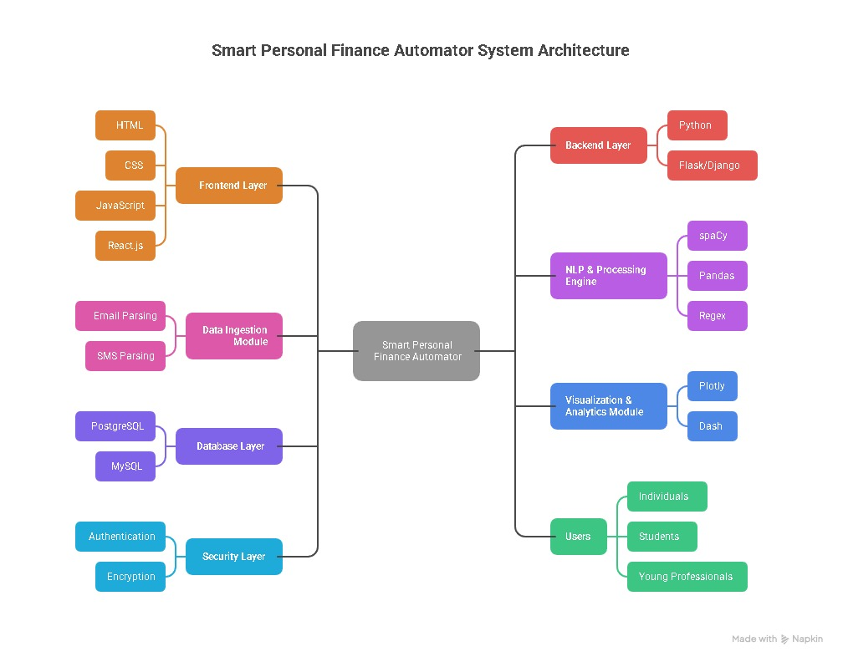
Architecture Diagram

Slide 13
​Modules
User Interface Module
Built with HTML, CSS, JavaScript.
Provides login, dashboard, visual reports, and savings insights.
Data Ingestion Module
Collects financial data from:
  Bank SMS (via Twilio API or simulation).
  Emails (via IMAP API).
  File uploads (optional).
Passes raw transaction data to the NLP Engine.
NLP & Processing Module
Uses Python, spaCy, Regex, and Pandas.
Extracts key details (amount, vendor, date, transaction type).
Categorizes expenses (groceries, utilities, entertainment, etc.).

Slide 14
​Modules
Backend Module
Powered by Python (Flask).
Manages authentication, API requests, business logic.
Connects NLP, Database, and Visualization modules.
Database Module
SQLite/MySQL.
Stores:
  User profiles & authentication.
  Encrypted financial data.
  Categorized transactions & recommendations.

Slide 15
​Modules
Visualization & Analytics Module
Built with Plotly.
Generates interactive graphs for spending trends, category breakdowns, and monthly comparisons.
Provides personalized savings recommendations.
Security Module
Authentication and authorization.
Encryption for stored and transmitted financial data.

Slide 16
Hardware and Software Details
Hardware:
Processor: Intel Core i3 / AMD Ryzen 3 or higher
RAM: 8 GB or more
Storage: 40 GB of free disk space
Software:
Operating System: Windows 10/11, macOS, or any Linux distribution
Backend Runtime: Python 3.8+Frontend Runtime: Node.js
Database Server: PostgreSQL or MySQL
Version Control: Git
IDE: VS Code or PyCharm

Slide 17
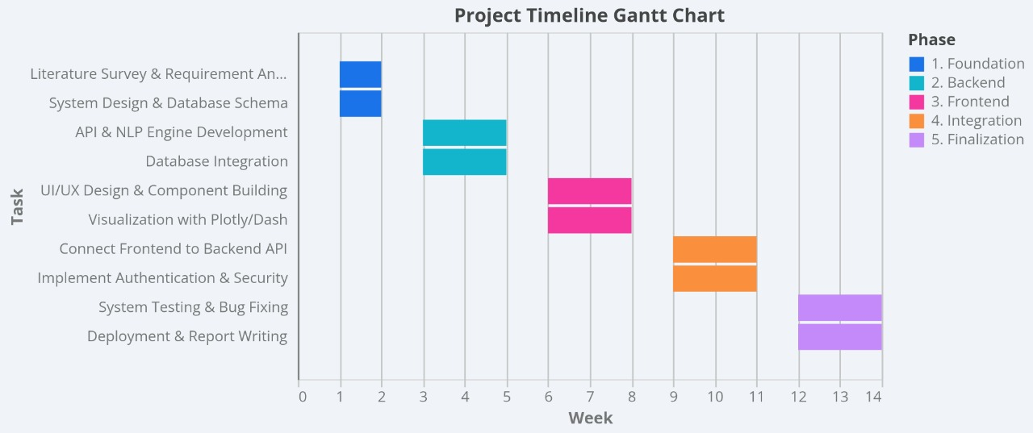
Timeline of the Project (Gantt Chart)

Slide 18
References (IEEE Paper format)
[1] S. Bird, E. Klein, and E. Loper, "Natural Language Processing with Python," O'Reilly Media, 2009.
[2] Plotly Technologies Inc., "Dash User Guide," 2023. [Online]. Available: https://dash.plotly.com
[3] spaCy, "Industrial-Strength NLP in Python," 2023. [Online]. Available: https://spacy.io
[4] M. Abadi, A. Agarwal, P. Barham et al., "TensorFlow: Large-Scale Machine Learning on Heterogeneous Systems," 2015. [Online]. Available: https://www.tensorflow.org
[5] R. Agarwal and A. Dhar, "Financial Inclusion through Digitalization: A Review of Financial Technologies," Int. J. Innov. Sci., vol. 13, no. 2, pp. 168–180, 2021.
[6] A. Jain, S. Kumar, and M. Singh, "AI-Driven Personal Finance Management Systems," Int. J. Comput. Appl.,vol. 183, no. 25, pp. 12–19, 2021.
[7] H. Chen, R. Chiang, and V. Storey, "Business Intelligence and Analytics: From Big Data to Big Impact," MISQ., vol. 36, no. 4, pp. 1165–1188, 2012.
[8] Y. LeCun, Y. Bengio, and G. Hinton, "Deep Learning," Nature, vol. 521, pp. 436–444, 2015.
[9] A. S. Syntetos and J. Boylan, "Forecasting for Financial Decision Making: Applications of Machine Learning,"Eur. J. Oper. Res., vol. 289, no. 3, pp. 838–850, 2021.
[10] M. Singh and S. Malhotra, "The Role of FinTech in Financial Services: Disruption and Opportunities," J. Bus. Res., vol. 146, pp. 112–120, 2022.

Slide 19


